Slide 1

Notes:
Duration: 10 Sec
Facilitator notes: WHAT:
What are you willing to achieve?
WHY:
Purpose of achievement.
HOW:
Steps need to be taken to complete this.

Slide 2
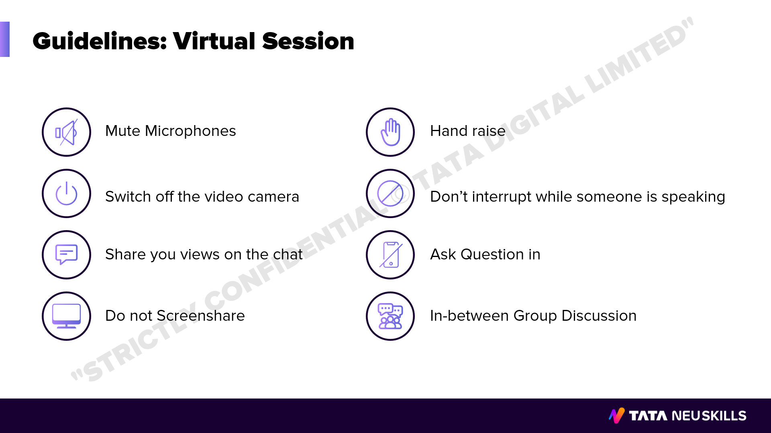
Notes:
Duration: 10 Sec
Facilitator notes: WHAT:
What are you willing to achieve?
WHY:
Purpose of achievement.
HOW:
Steps need to be taken to complete this.

Slide 3
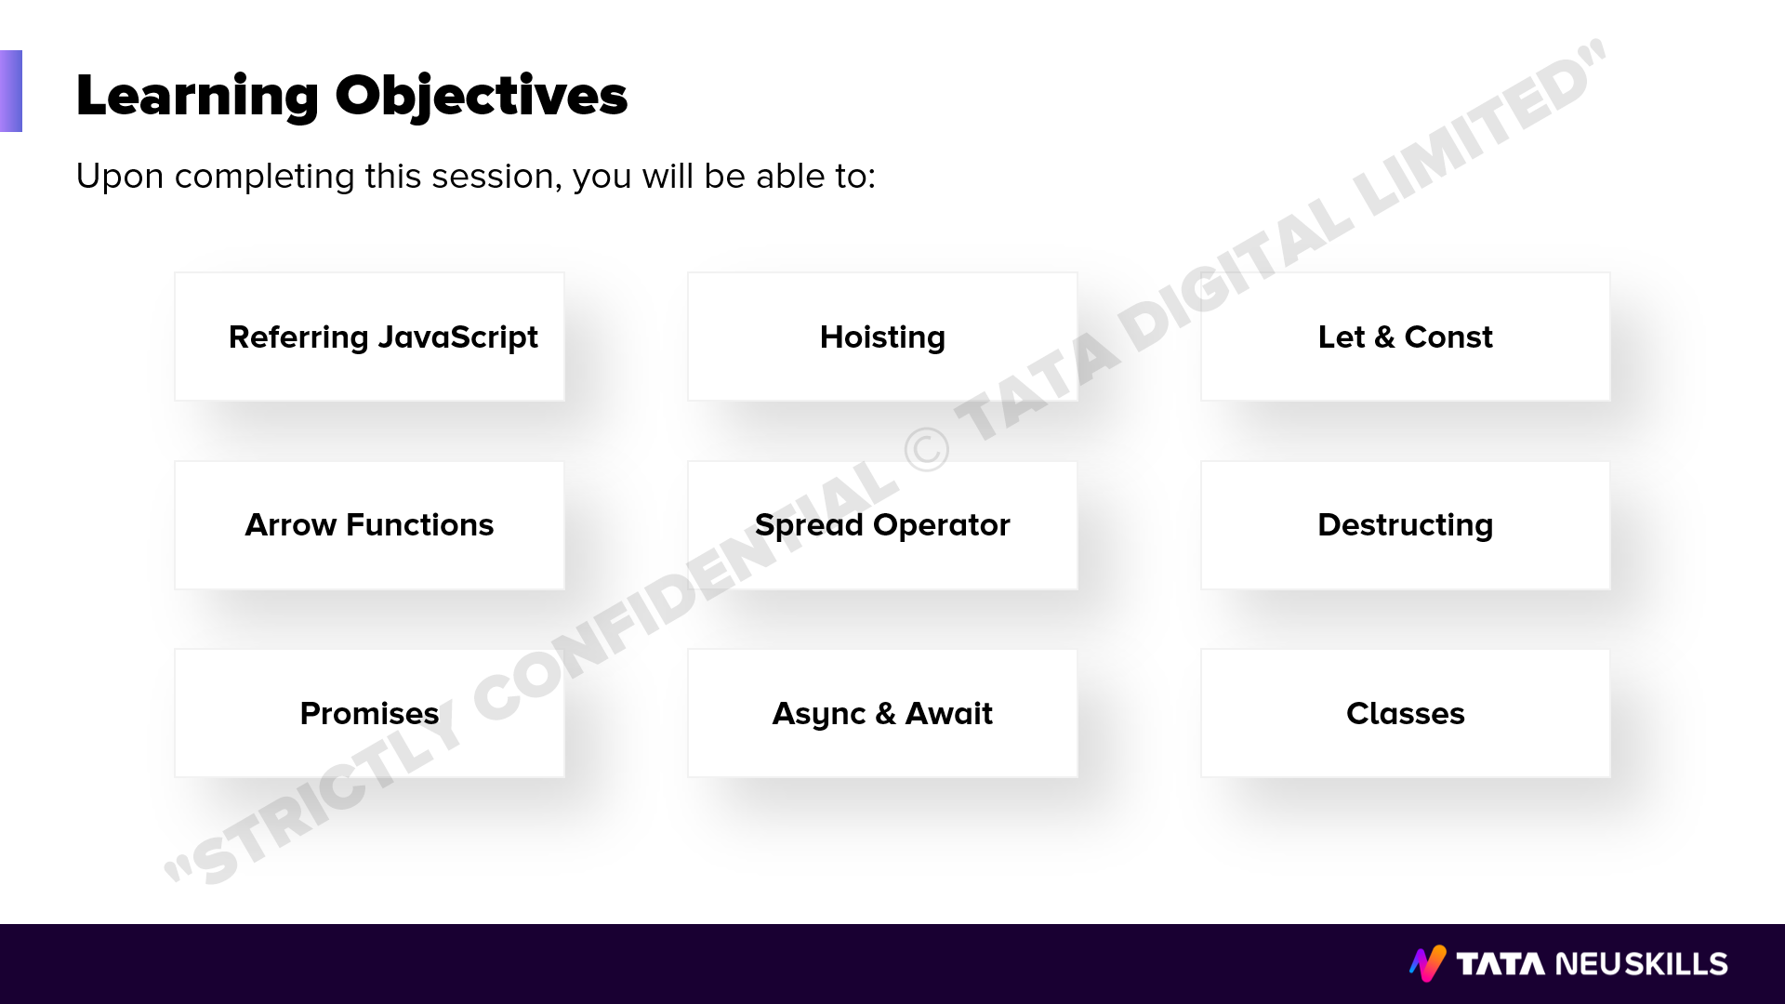
Notes:
Duration: 10 Sec
Facilitator notes: WHAT:
What are you willing to achieve?
WHY:
Purpose of achievement
HOW:
Steps need to be taken to complete this.

Slide 4

Notes:
Duration: 10 Sec
Facilitator notes: WHAT:
What are you willing to achieve?
WHY:
Purpose of achievement
HOW:
Steps need to be taken to complete this.

Slide 5


Slide 6
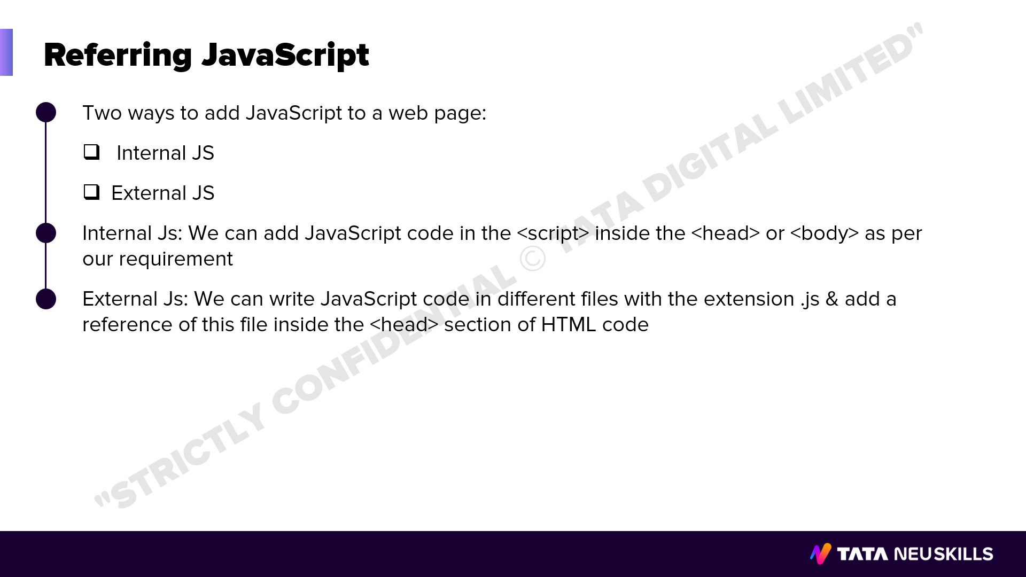
Notes:
Duration: 5 minutes
Facilitator notes: WHAT:
WHY:
HOW:

Slide 7
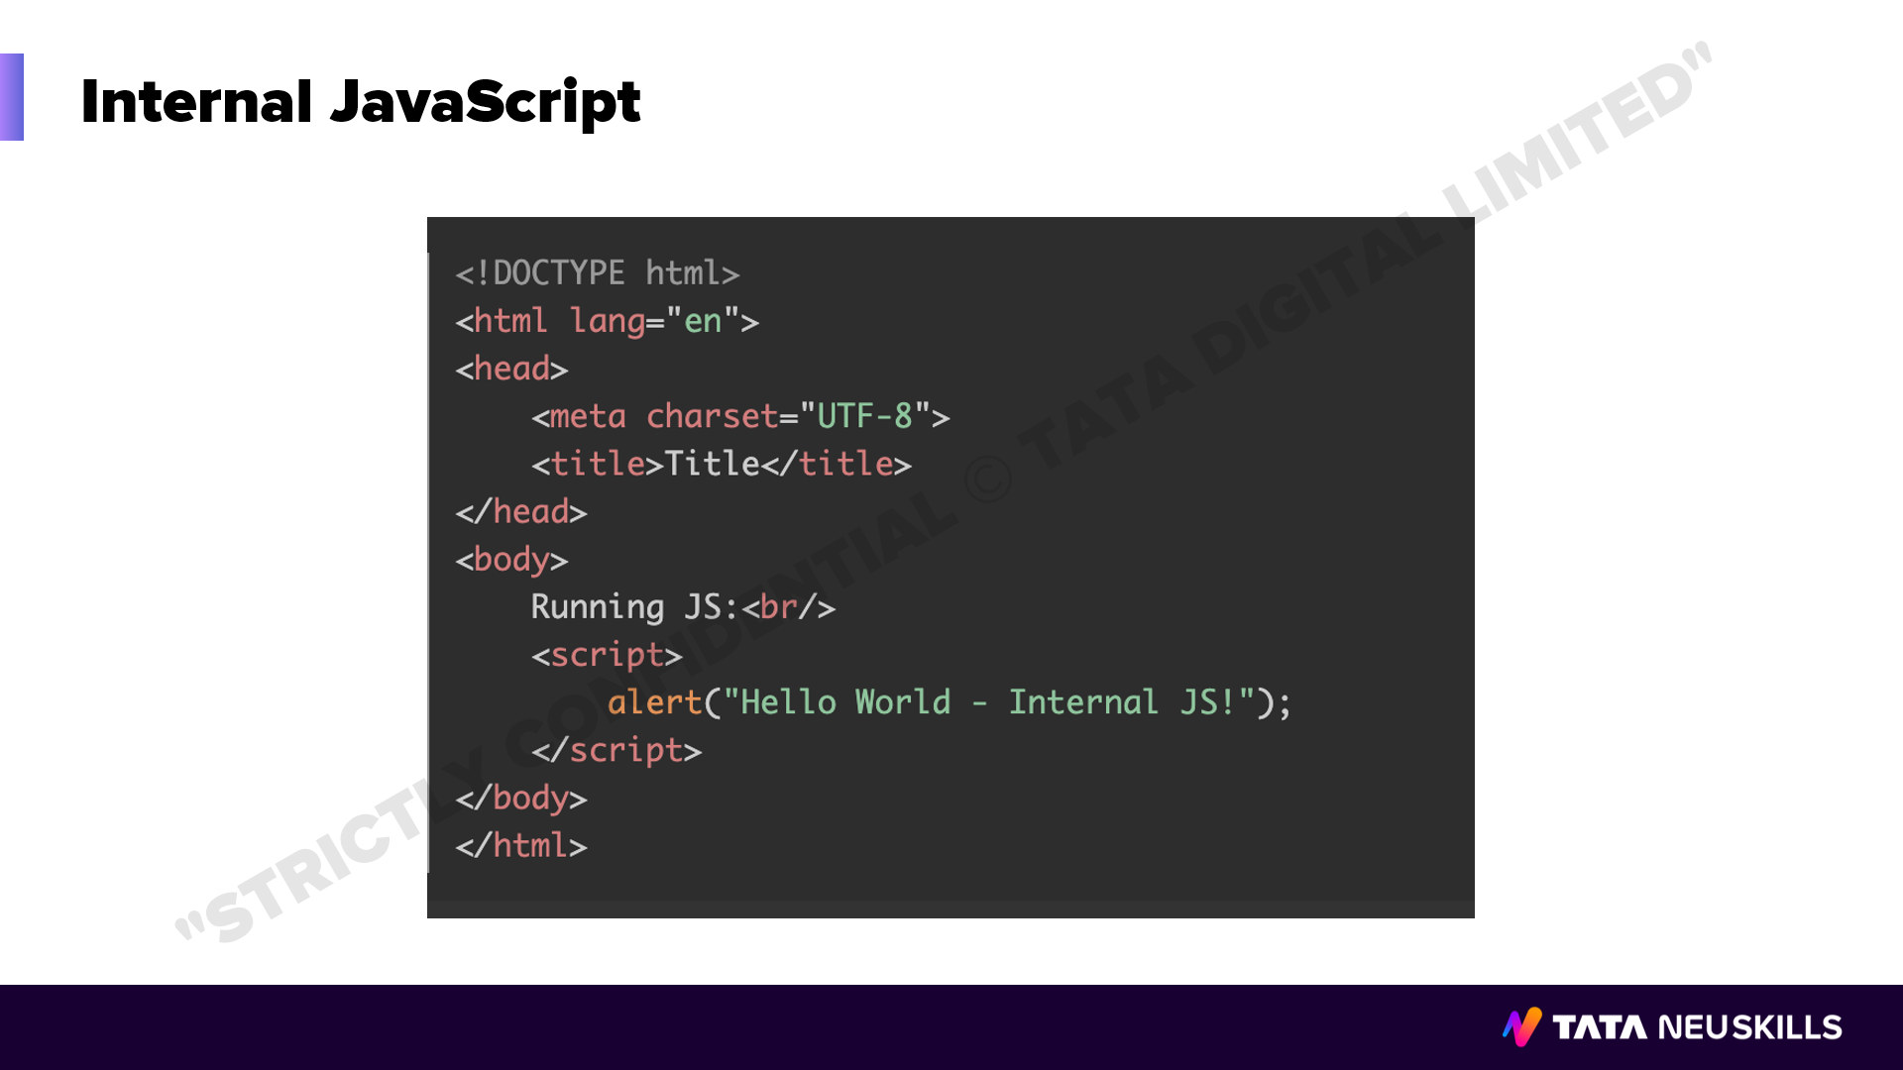
Notes:
Duration: 5 minutes
Facilitator notes: WHAT:
WHY:
HOW:

Slide 8
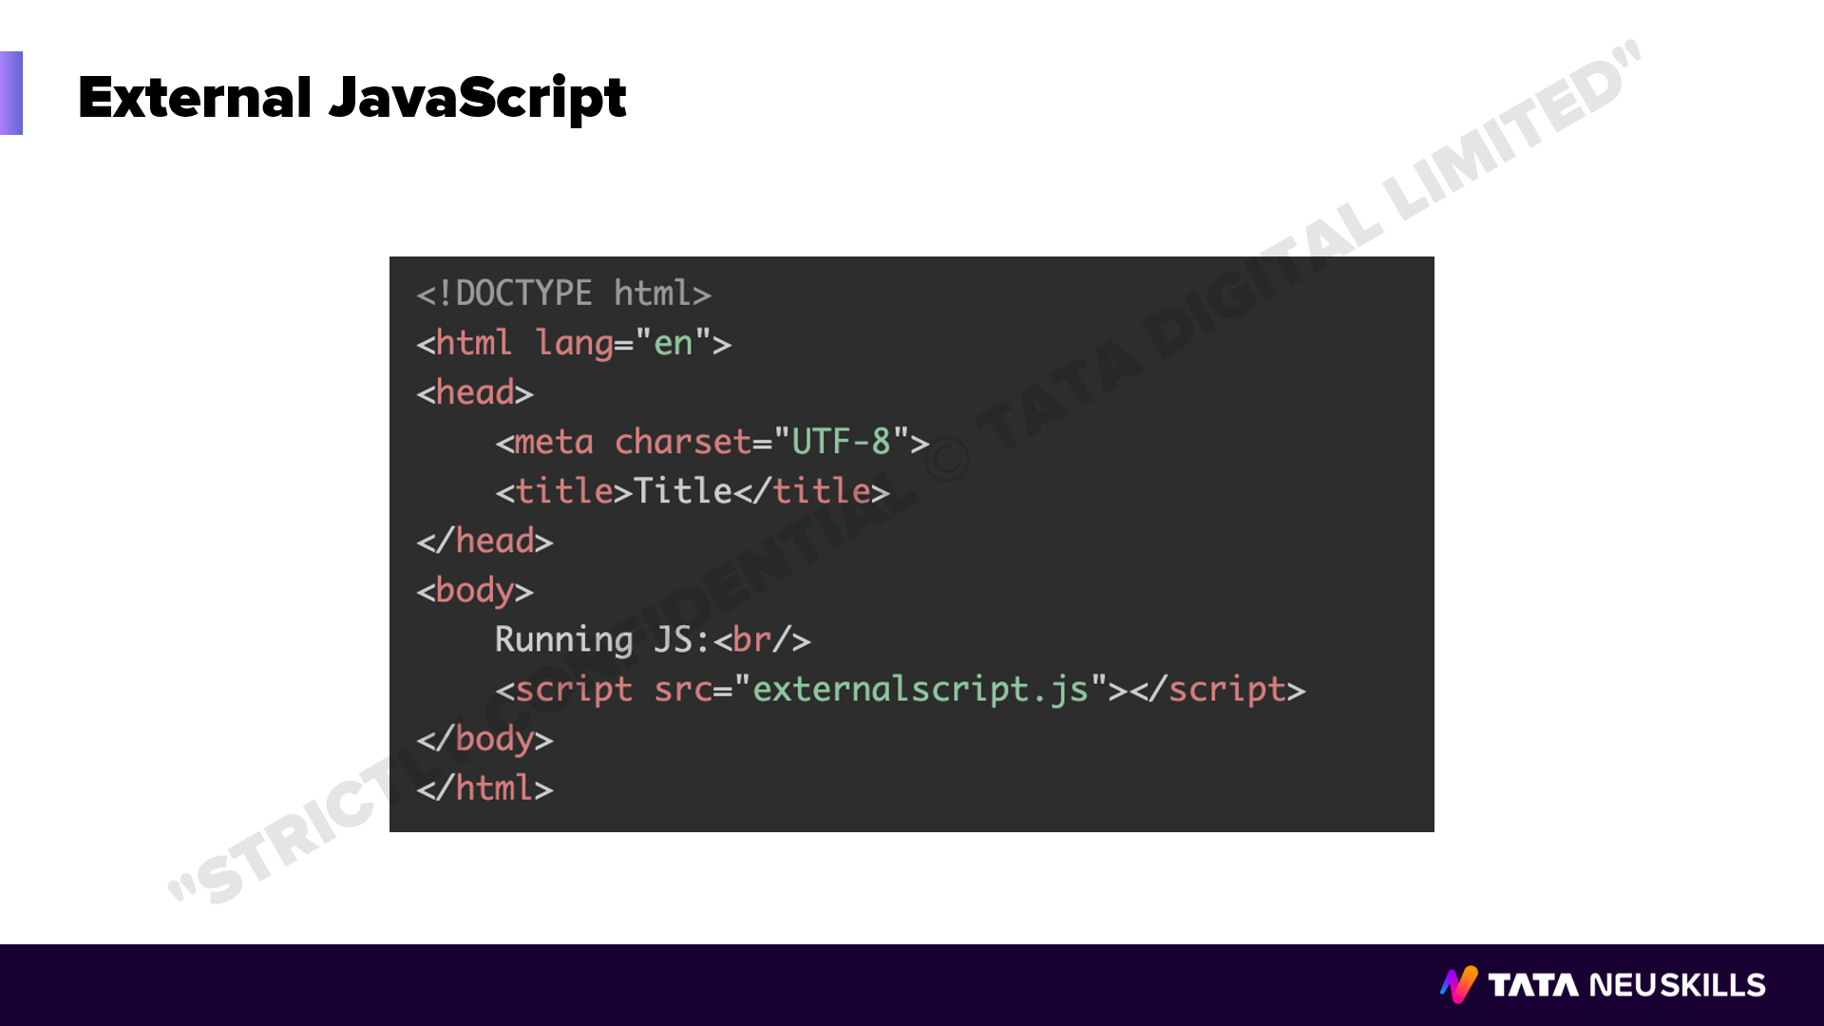
Notes:
Duration: 5 minutes
Facilitator notes: WHAT:
WHY:
HOW:

Slide 9
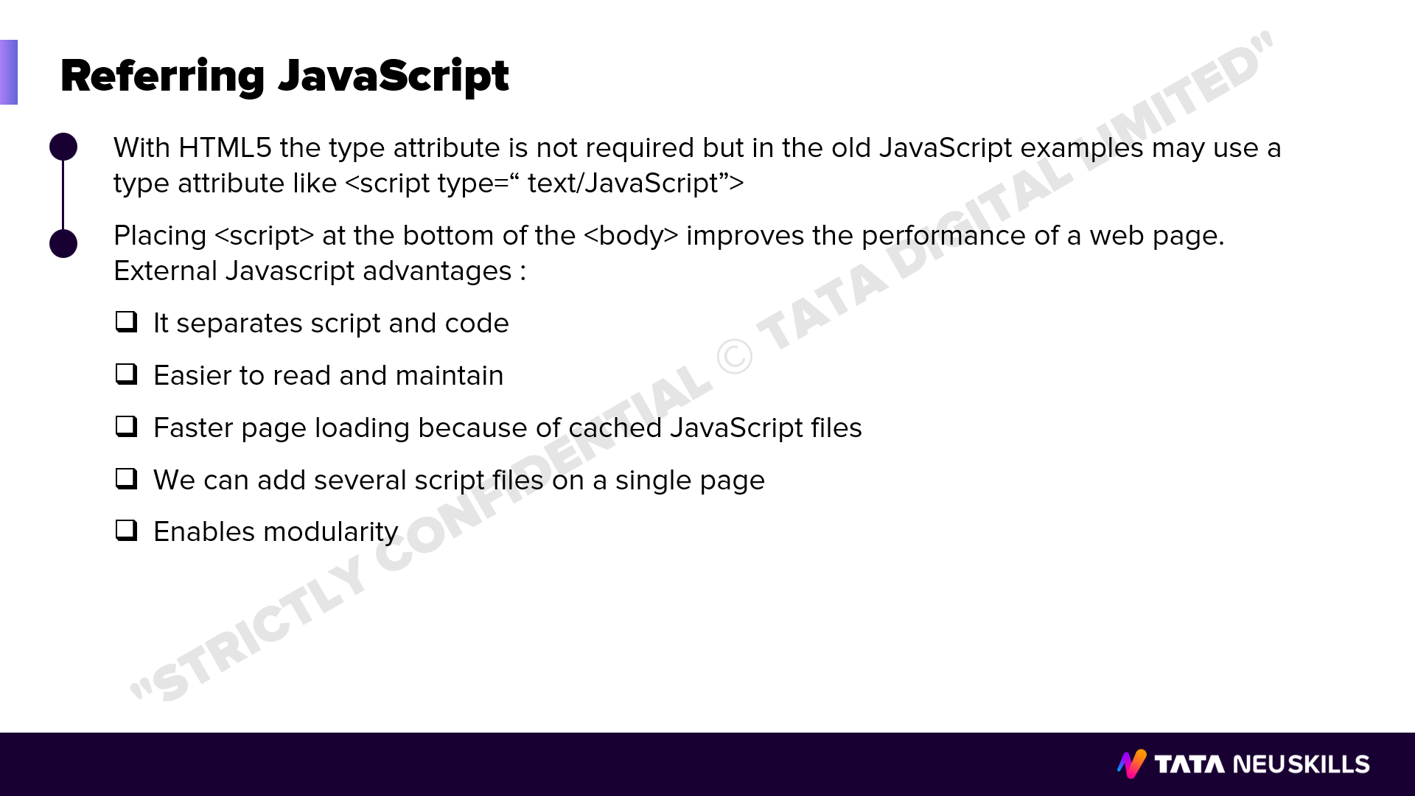
Notes:
Duration: 5 minutes
Facilitator notes: WHAT:
WHY:
HOW:

Slide 10

Notes:
Duration: 10 minutes
Facilitator notes: WHAT:
What are you willing to achieve?
WHY:
Purpose of achievement
HOW:
Steps need to be taken to complete this.

Slide 11


Slide 12
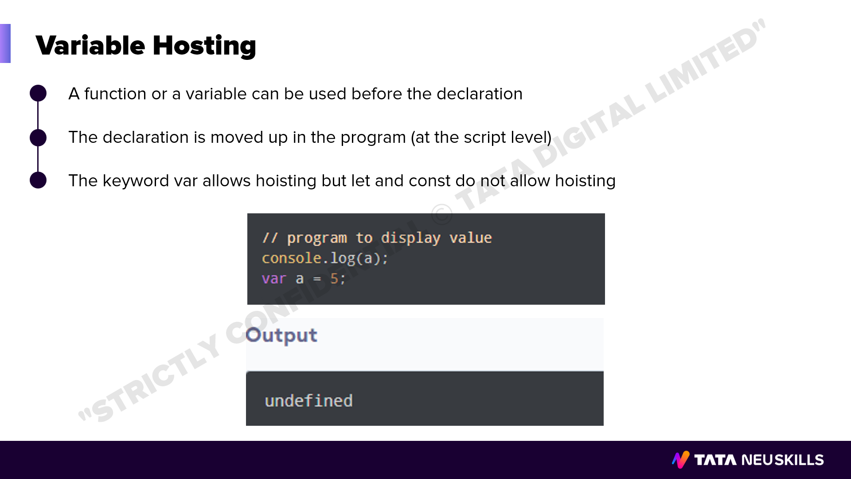
Notes:
Duration: 5 minutes
Facilitator notes: WHAT:
WHY:
HOW:

Slide 13

Notes:
Duration: 5 minutes
Facilitator notes: WHAT:
WHY:
HOW:

Slide 14
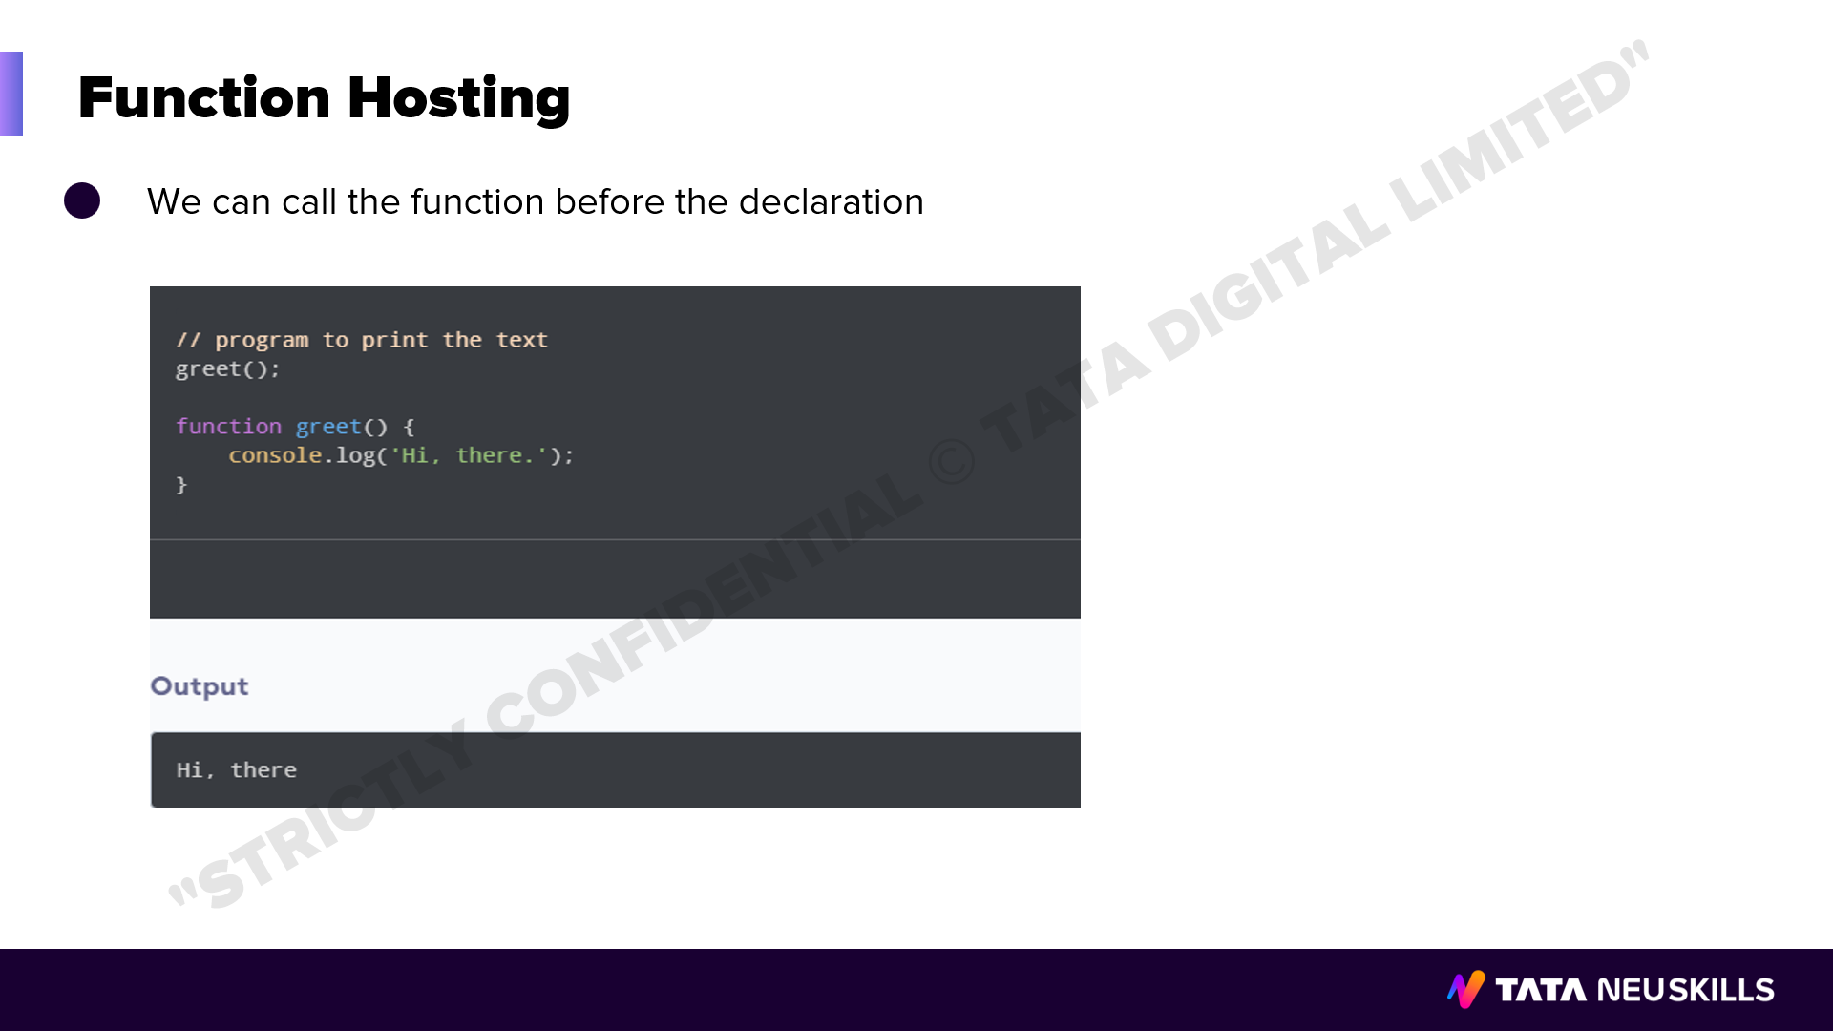
Notes:
Duration: 5 minutes
Facilitator notes: WHAT:
WHY:
HOW:

Slide 15
Notes:
Duration: 10 minutes
Facilitator notes: WHAT:
What are you willing to achieve?
WHY:
Purpose of achievement
HOW:
Steps need to be taken to complete this.

Slide 16


Slide 17
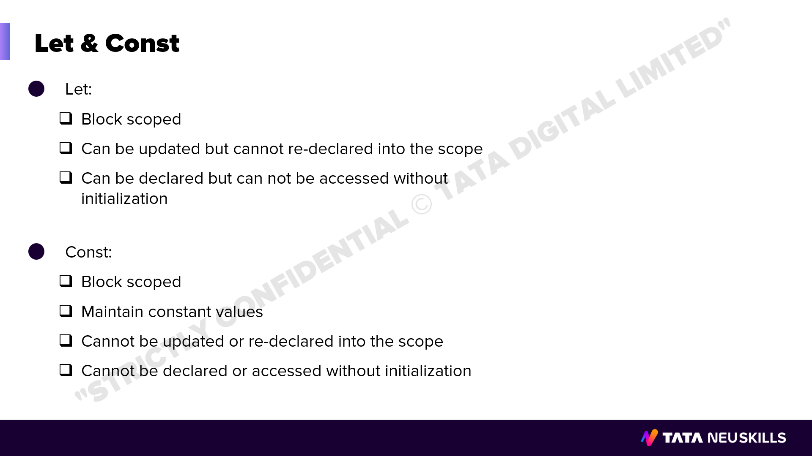
Notes:
Duration: 5 minutes
Facilitator notes: WHAT:
WHY:
HOW:

Slide 18
Notes:
Duration: 10 minutes
Facilitator notes: WHAT:
What are you willing to achieve?
WHY:
Purpose of achievement
HOW:
Steps need to be taken to complete this.

Slide 19


Slide 20
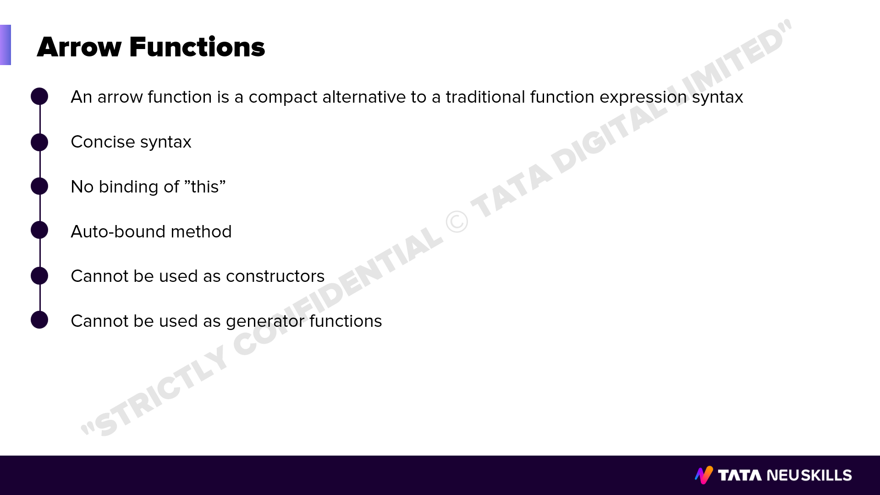
Notes:
Duration: 5 minutes
Facilitator notes: WHAT:
WHY:
HOW:

Slide 21
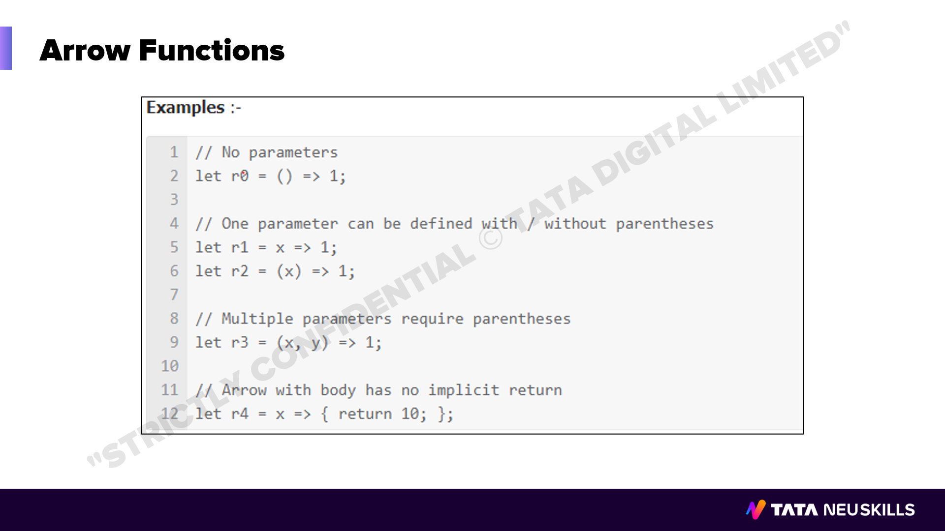
Notes:
Duration: 5 minutes
Facilitator notes: WHAT:
WHY:
HOW:

Slide 22
Notes:
Duration: 10 minutes
Facilitator notes: WHAT:
What are you willing to achieve?
WHY:
Purpose of achievement
HOW:
Steps need to be taken to complete this.

Slide 23


Slide 24
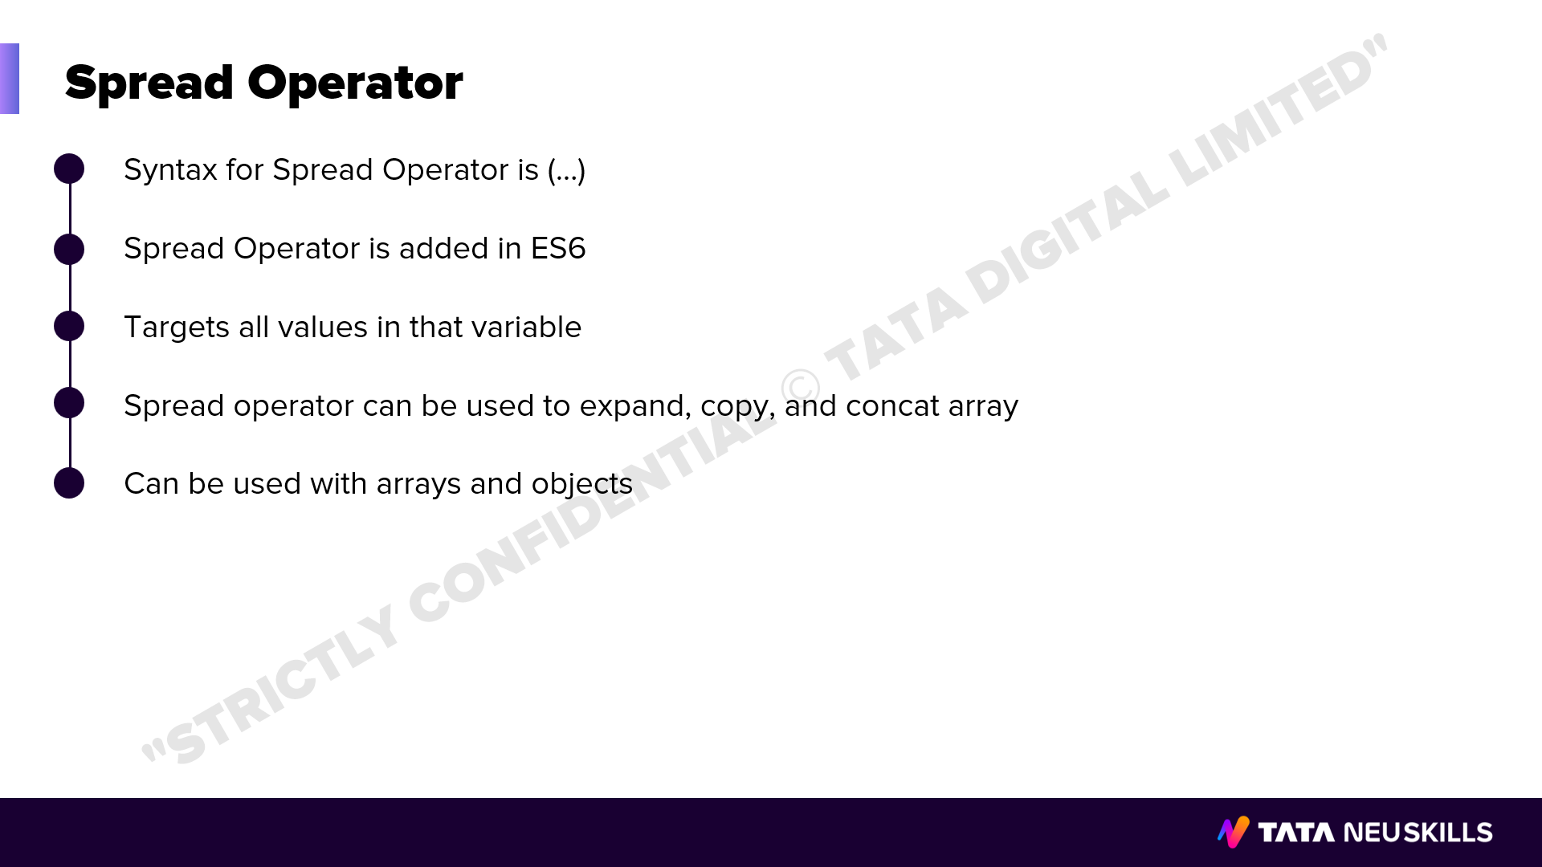
Notes:
Duration: 5 minutes
Facilitator notes: WHAT:
WHY:
HOW:

Slide 25
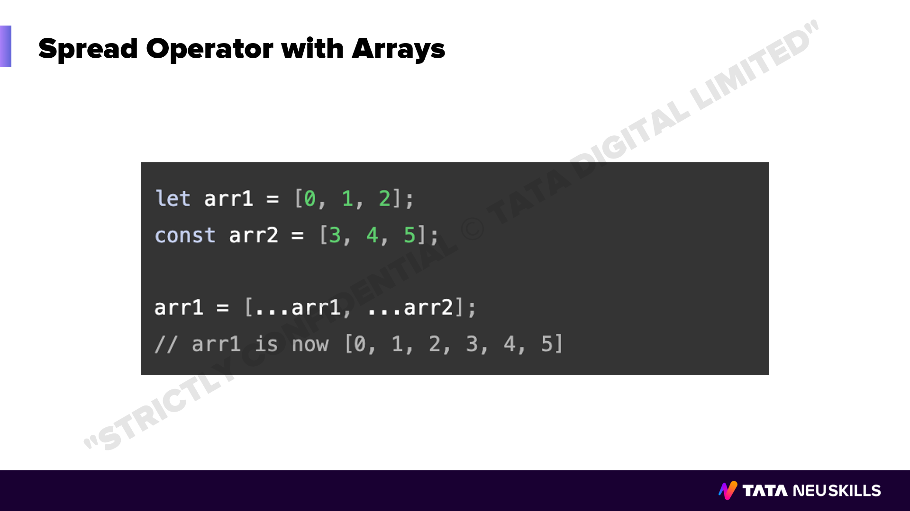
Notes:
Duration: 5 minutes
Facilitator notes: WHAT:
WHY:
HOW:

Slide 26
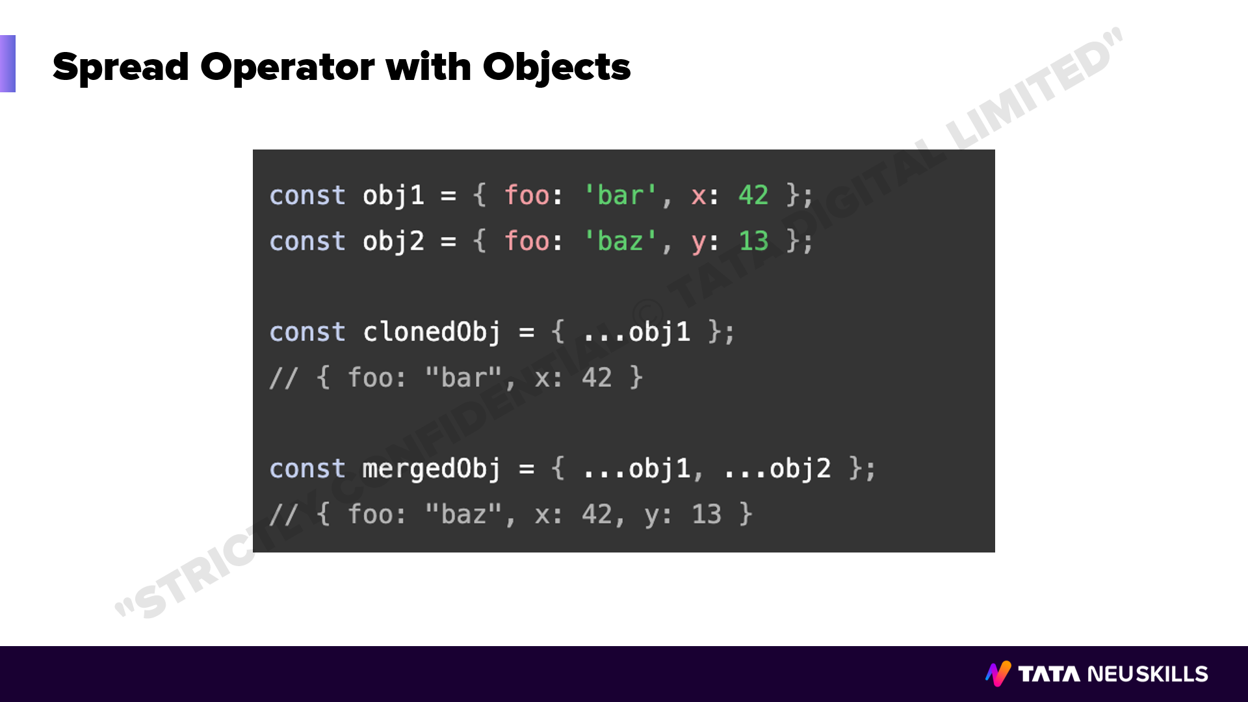
Notes:
Duration: 5 minutes
Facilitator notes: WHAT:
WHY:
HOW:
.

Slide 27
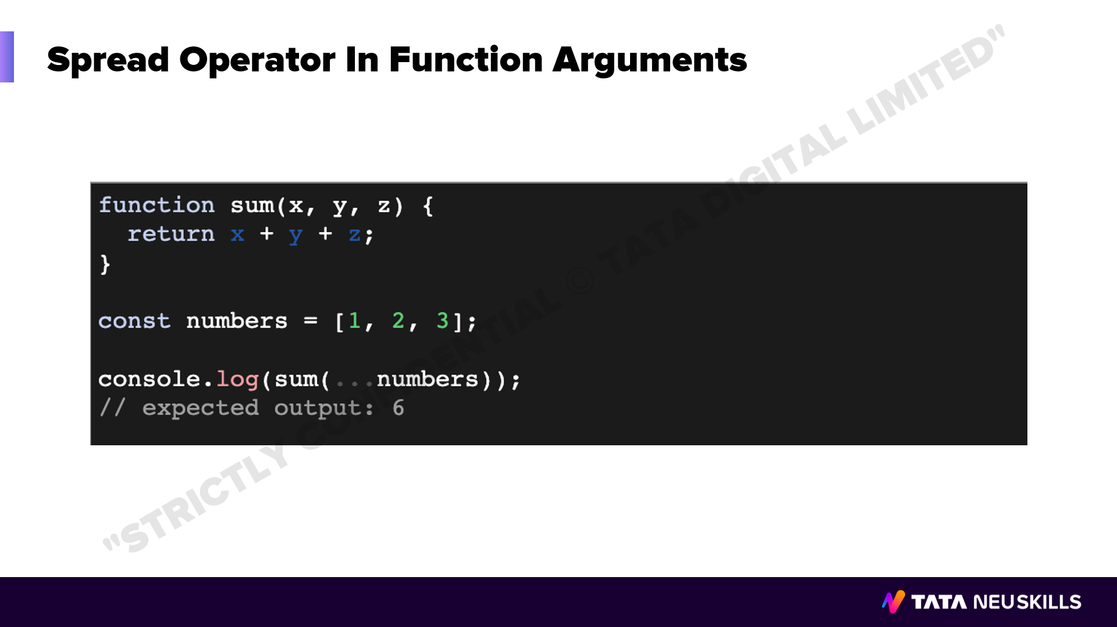
Notes:
Duration: 5 minutes
Facilitator notes: WHAT:
WHY:
HOW:

Slide 28
Notes:
Duration: 10 minutes
Facilitator notes: WHAT:
What are you willing to achieve?
WHY:
Purpose of achievement
HOW:
Steps need to be taken to complete this.

Slide 29


Slide 30
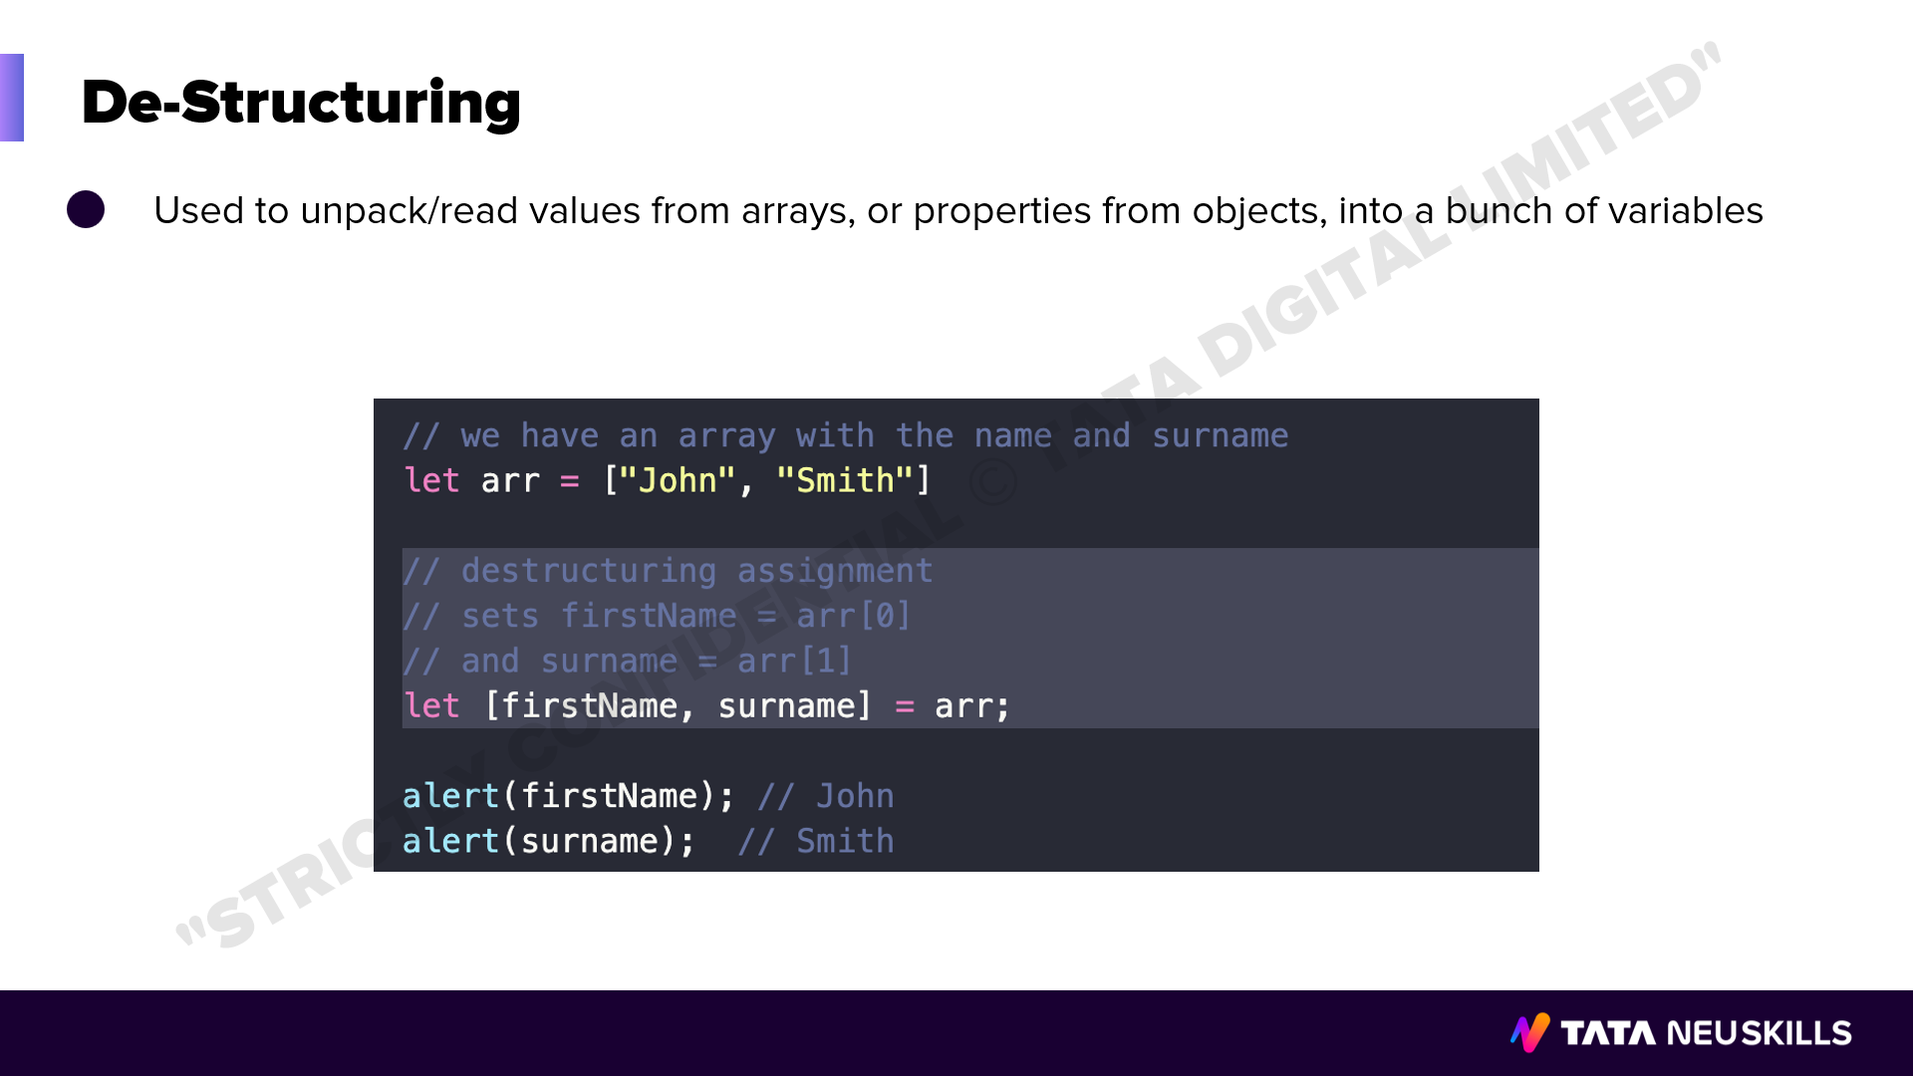
Notes:
Duration: 10 Sec
Facilitator notes: WHAT:
What are you willing to achieve?
WHY:
Purpose of achievement
HOW:
Steps need to be taken to complete this.

Slide 31
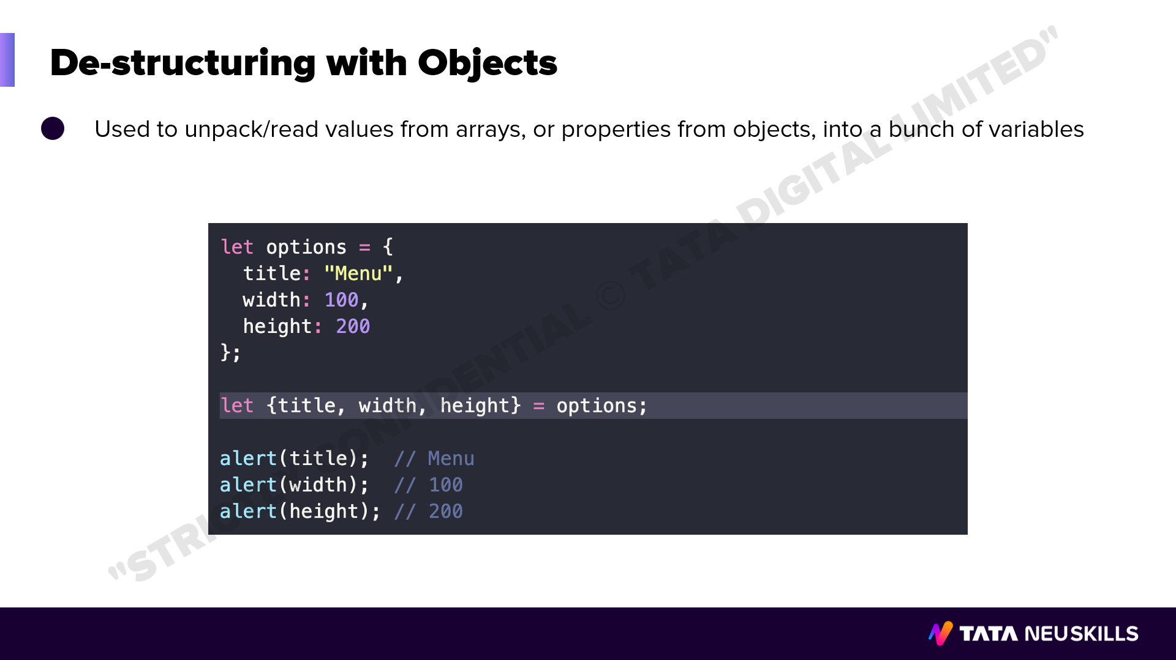
Notes:
Duration: 10 Sec
Facilitator notes: WHAT:
What are you willing to achieve?
WHY:
Purpose of achievement
HOW:
Steps need to be taken to complete this.

Slide 32
Notes:
Duration: 10 minutes
Facilitator notes: WHAT:
What are you willing to achieve?
WHY:
Purpose of achievement
HOW:
Steps need to be taken to complete this.

Slide 33


Slide 34
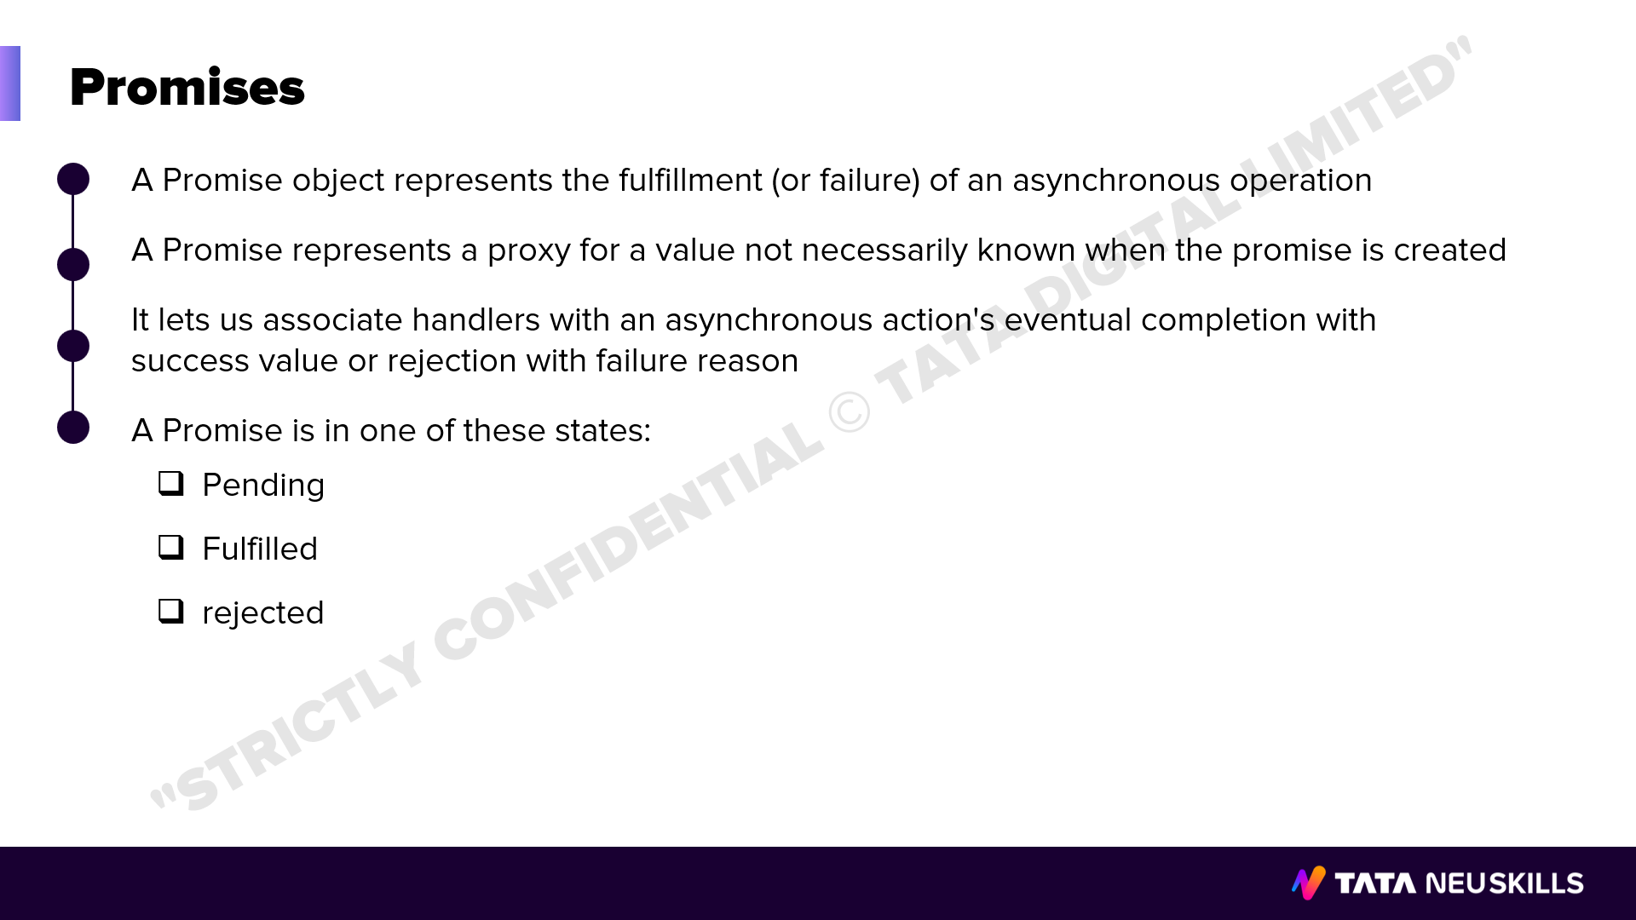
Notes:
Duration: 5 minutes
Facilitator notes: WHAT:
WHY:
HOW:

Slide 35
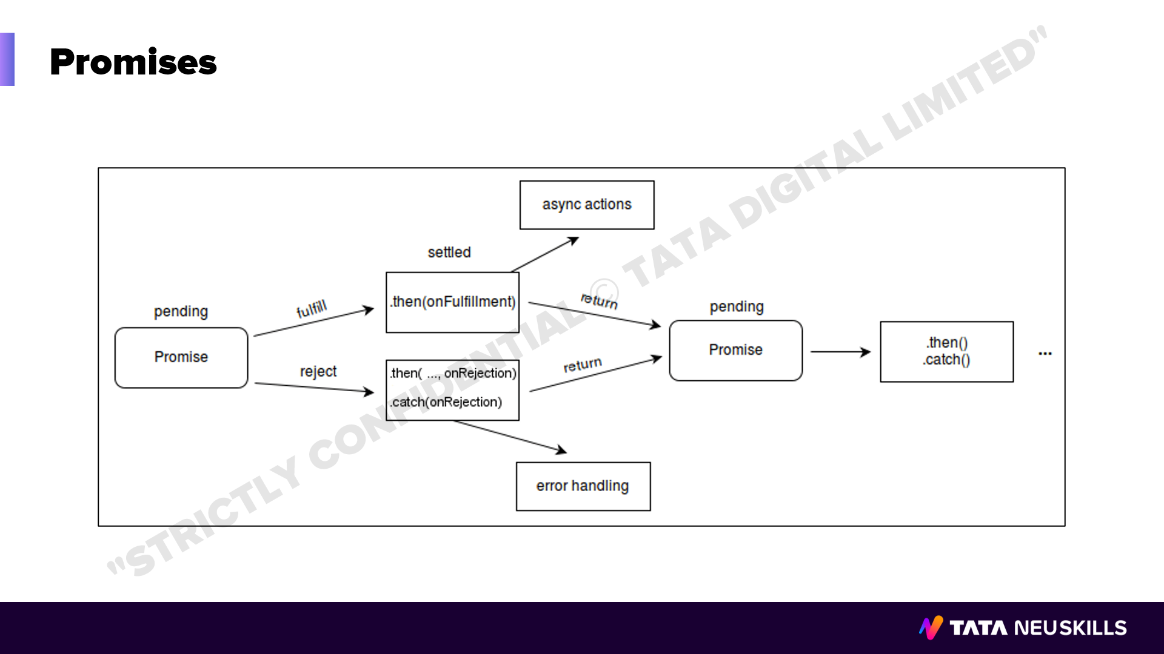
Notes:
Duration: 5 minutes
Facilitator notes: WHAT:
WHY:
HOW:

Slide 36
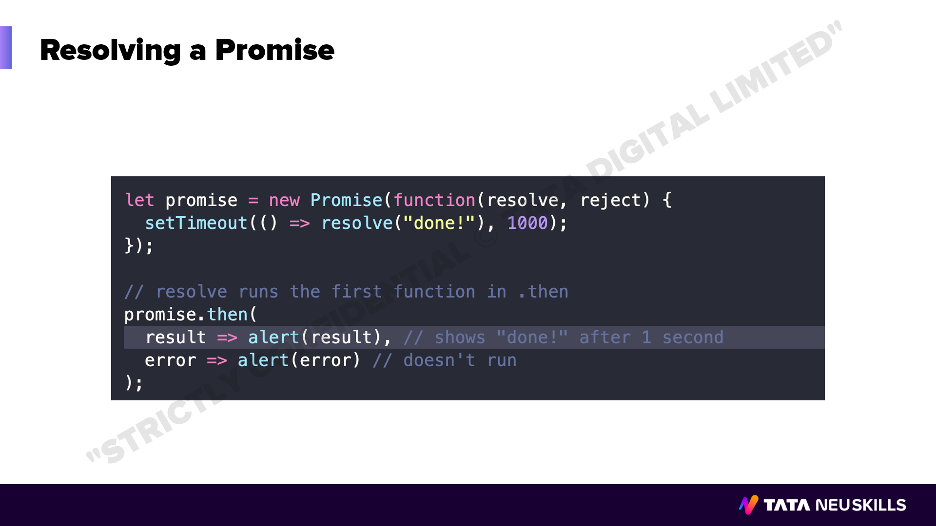
Notes:
Duration: 5 minutes
Facilitator notes: WHAT:
WHY:
HOW:

Slide 37
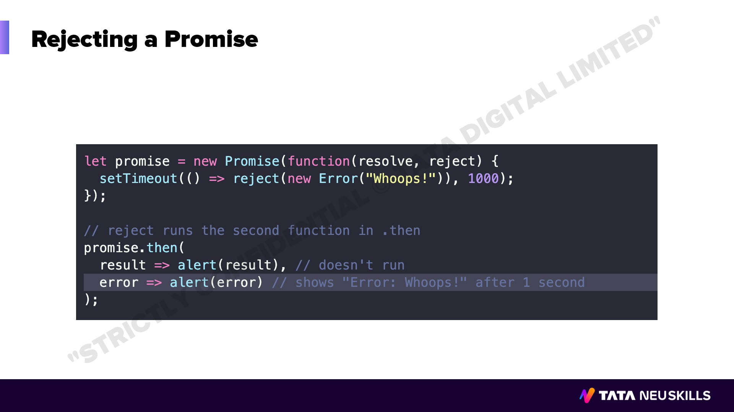
Notes:
Duration: 5 minutes
Facilitator notes: WHAT:
WHY:
HOW:

Slide 38
Notes:
Duration: 10 minutes
Facilitator notes: WHAT:
What are you willing to achieve?
WHY:
Purpose of achievement
HOW:
Steps need to be taken to complete this.

Slide 39
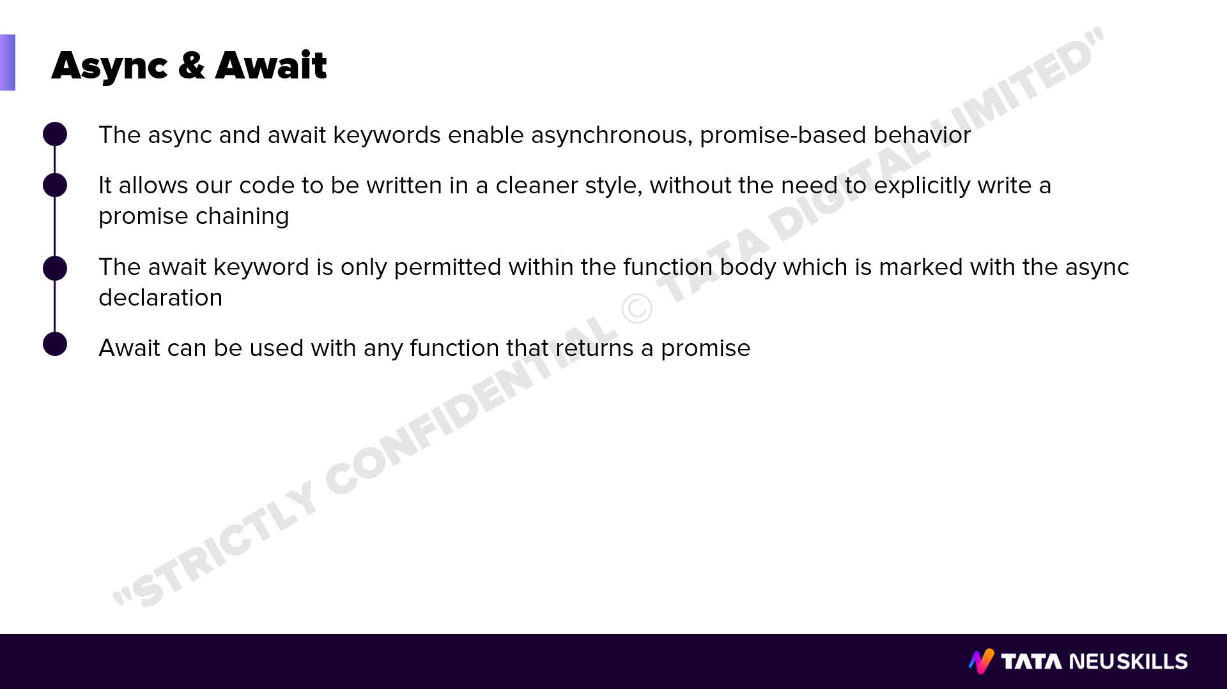
Notes:
Duration: 5 minutes
Facilitator notes: WHAT:
WHY:
HOW:

Slide 40
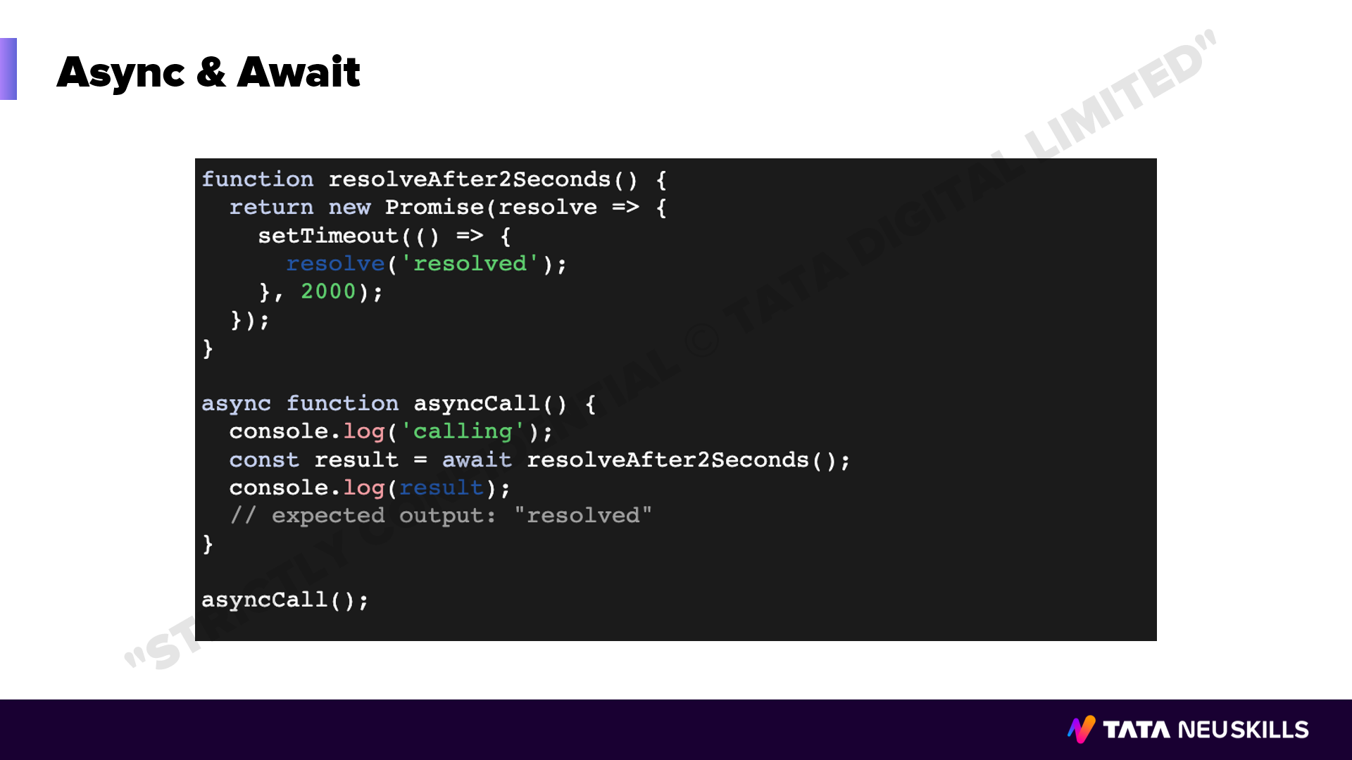
Notes:
Duration: 5 minutes
Facilitator notes: WHAT:
WHY:
HOW:

Slide 41
Notes:
Duration: 10 minutes
Facilitator notes: WHAT:
What are you willing to achieve?
WHY:
Purpose of achievement
HOW:
Steps need to be taken to complete this.

Slide 42


Slide 43
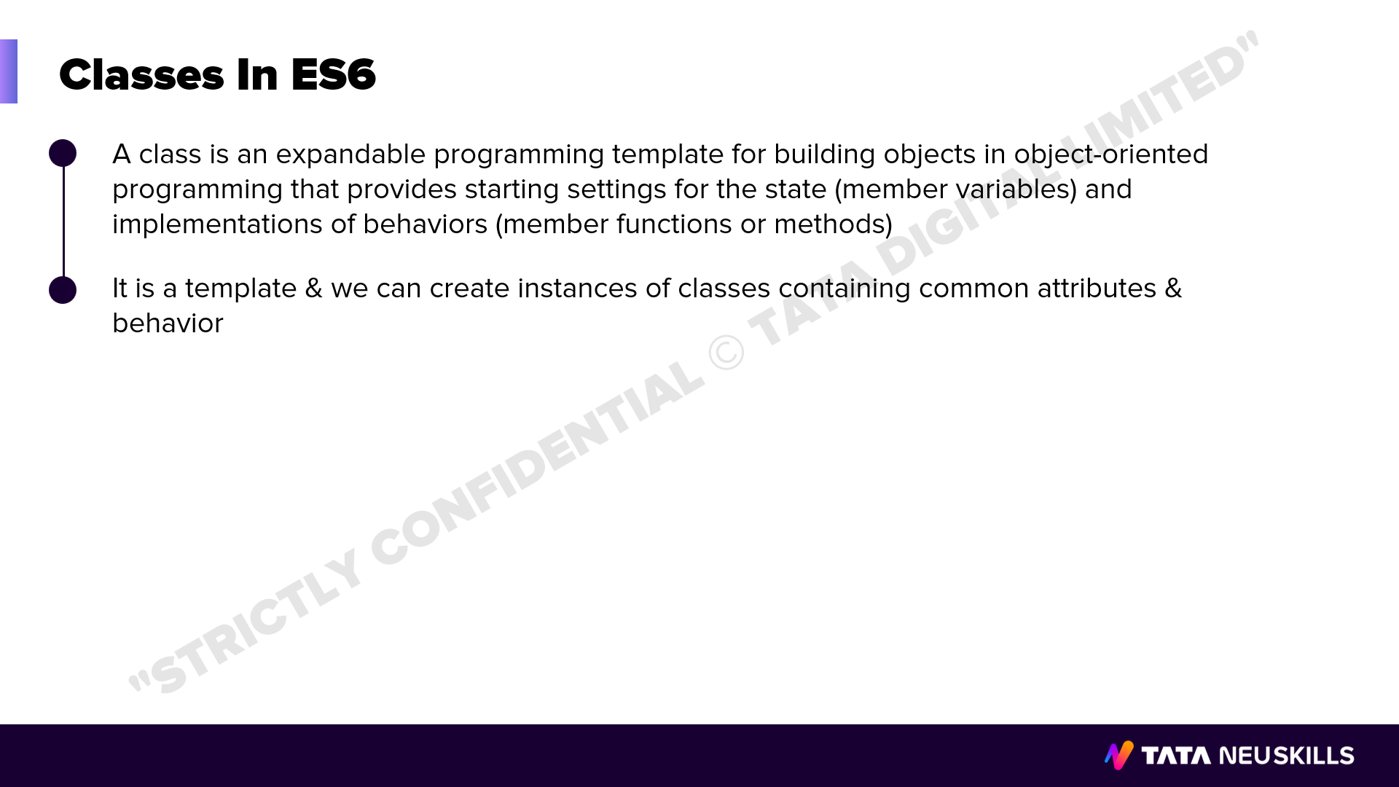
Notes:
Duration: 5 minutes
Facilitator notes: WHAT:
WHY:
HOW:

Slide 44
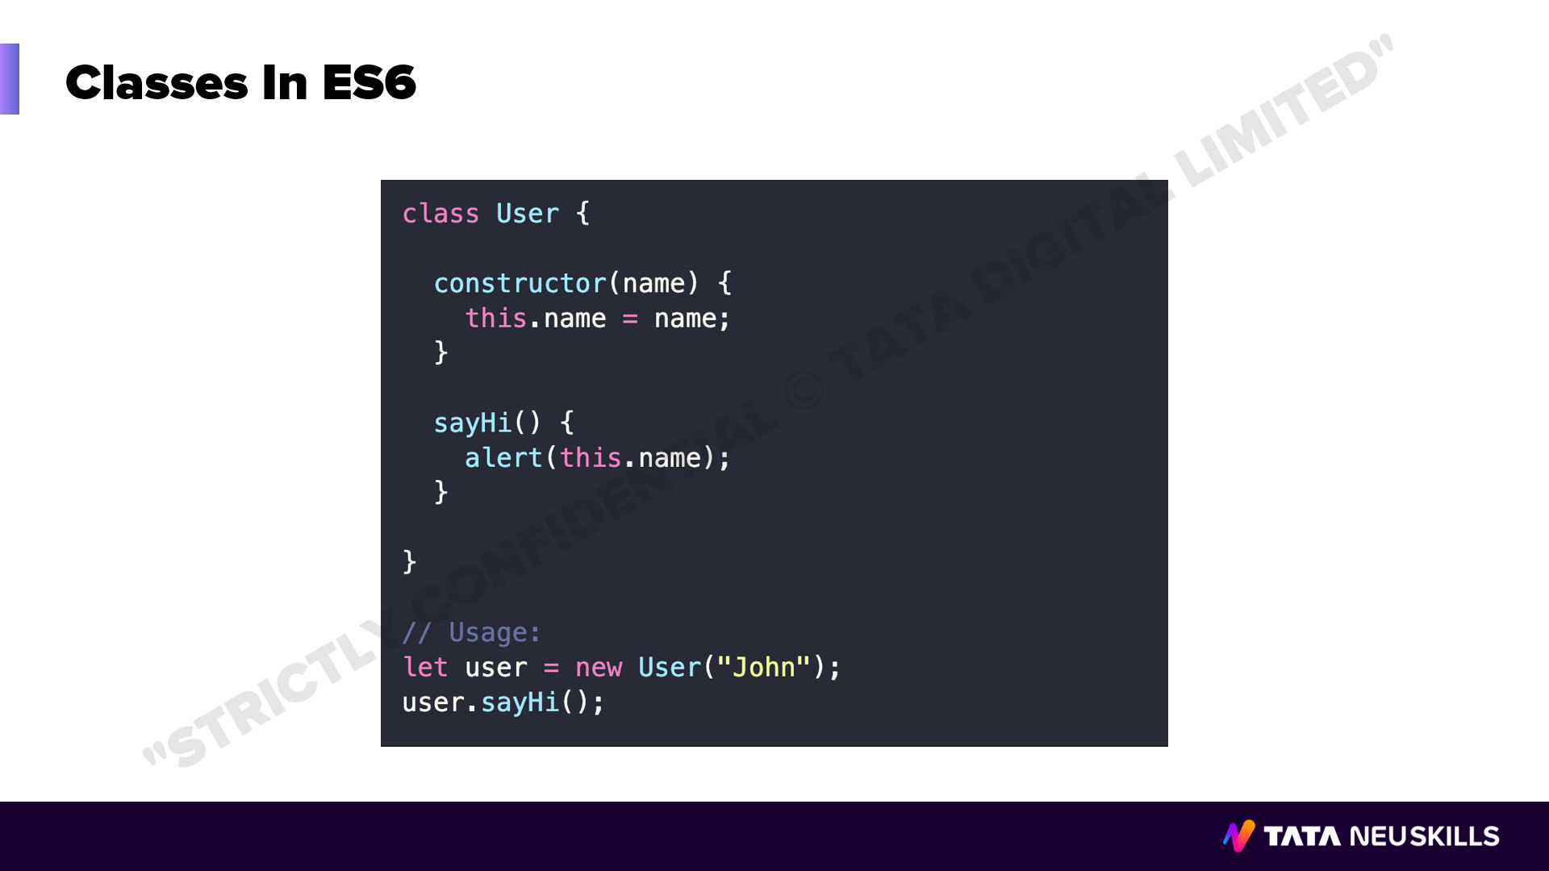
Notes:
Duration: 5 minutes
Facilitator notes: WHAT:
WHY:
HOW:

Slide 45
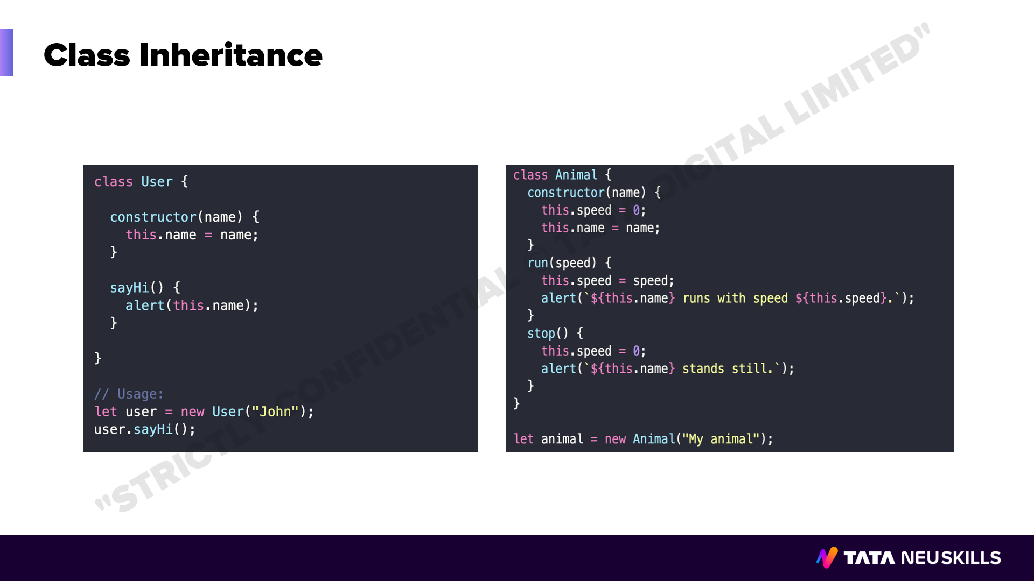
Notes:
Duration: 5 minutes
Facilitator notes: WHAT:
WHY:
HOW:

Slide 46
Notes:
Duration: 10 minutes
Facilitator notes: WHAT:
What are you willing to achieve?
WHY:
Purpose of achievement
HOW:
Steps need to be taken to complete this.

Slide 47
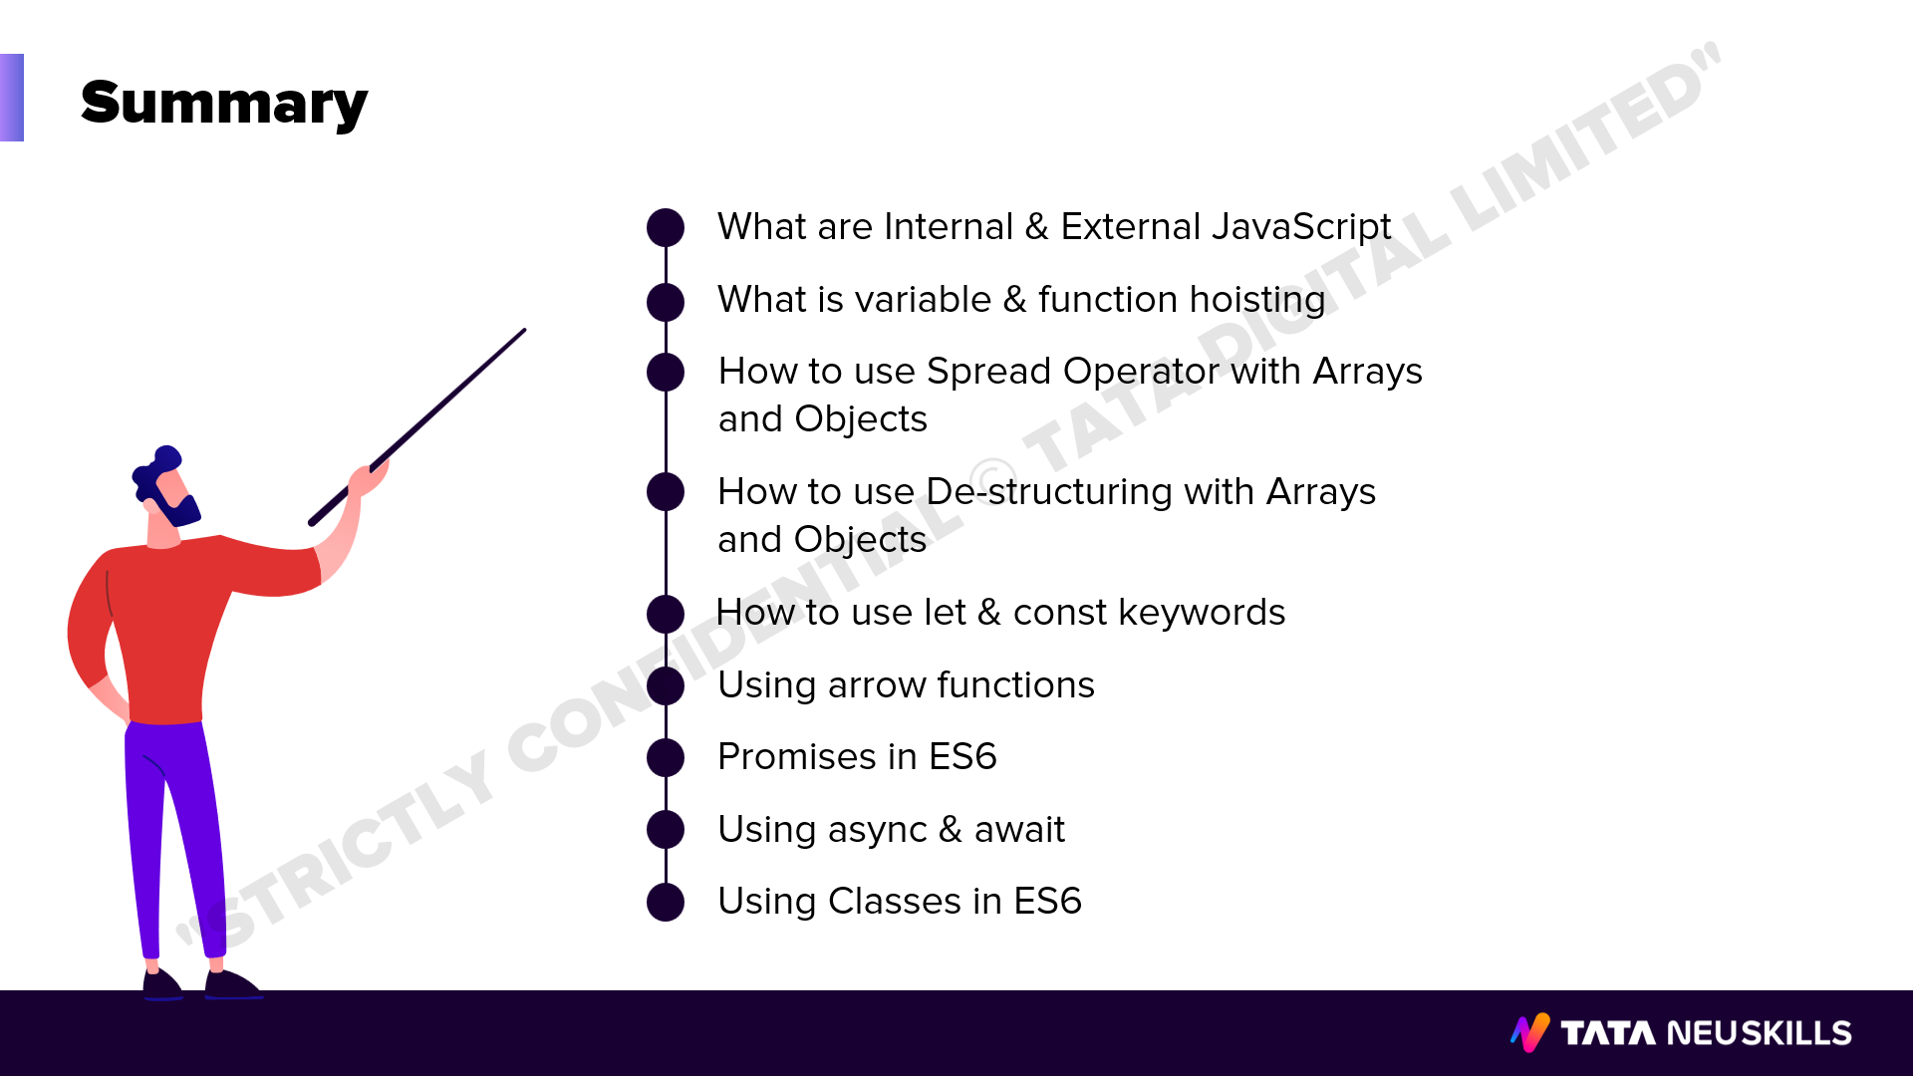
Notes:
Duration: 10 Sec
Facilitator notes: WHAT:
What are you willing to achieve?
WHY:
Purpose of achievement
HOW:
Steps need to be taken to complete this.

Slide 48

Notes:
Duration: 10 Sec
Facilitator notes: WHAT:
What are you willing to achieve?
WHY:
Purpose of achievement
HOW:
Steps need to be taken to complete this.

Slide 49

Notes:
Duration: 10 Sec
Facilitator notes: WHAT:
What are you willing to achieve?
WHY:
Purpose of achievement
HOW:
Steps need to be taken to complete this.

